Slide 1
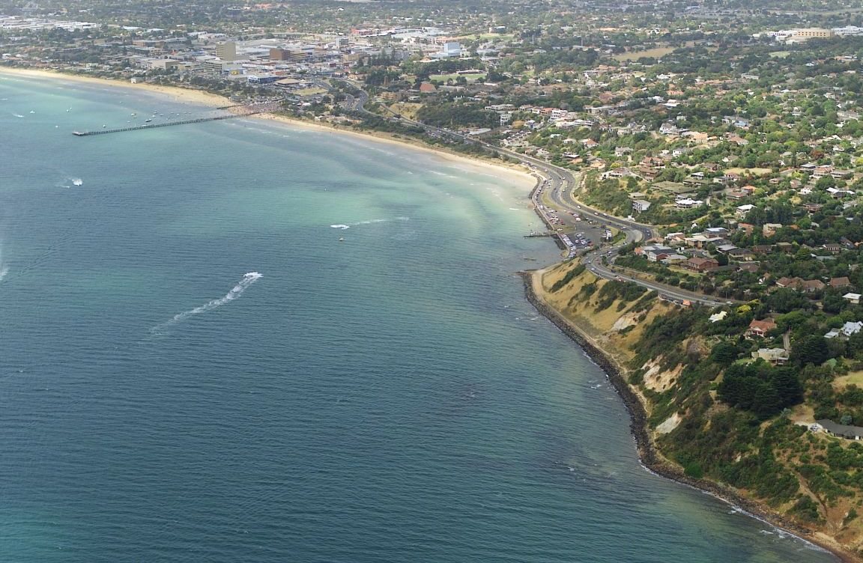
REGIONAL GROWTH
Frankston and surrounds
7 June 2013
Urban Development Institute of Australia
Presented by:
Mark Holland, FAPI CPV SRV
Head of Advisory

Slide 2
Disclaimer
This presentation is provided as general information only and does not consider any one’s specific objectives, situation or needs. You should not rely on the information in it. Opteon (including its subsidiaries) do not accept any duty of care or liability to anyone regarding this presentation or any loss suffered in connection with the use of it or any of its content.
It is important that you seek professional advice before making a decision or alter your circumstances. By seeking assistance, your objectives can be analysed to determine the value of the information contained within this presentation.
This presentation is based on our understanding of current legislation. Legislation may change and this may affect the accuracy of this information and its relevance to your personal situation.
To the maximum extent permitted by law, Opteon (including its subsidiaries), its employees, representatives or any other person accept no liability for any error or omission in this presentation or for any resulting loss or damage suffered by you or any other person.

Slide 3
Outline
POPULATION TRENDS
REGIONAL ACCCESSIBILITY
LAND USES & where people live
PRODUCTIVE OUTPUT
EMPLOYMENT GROWTH
RESIDENTIAL MEDIAN HOUSE PRICE TRENDS
THE FUTURE FOR FRANKSTON
TESTIMONIALS (video)

Slide 4
Population Age Structures 2003 to 2011
Source: ABS & VIF 2012

Slide 5
Population Age Structures Projections 2006 to 2031
2021 - 60+ = 18.88% - 24,927
2031 - 60+ = 26.69% - 40,830
Source: ABS & VIF 2012

Slide 6
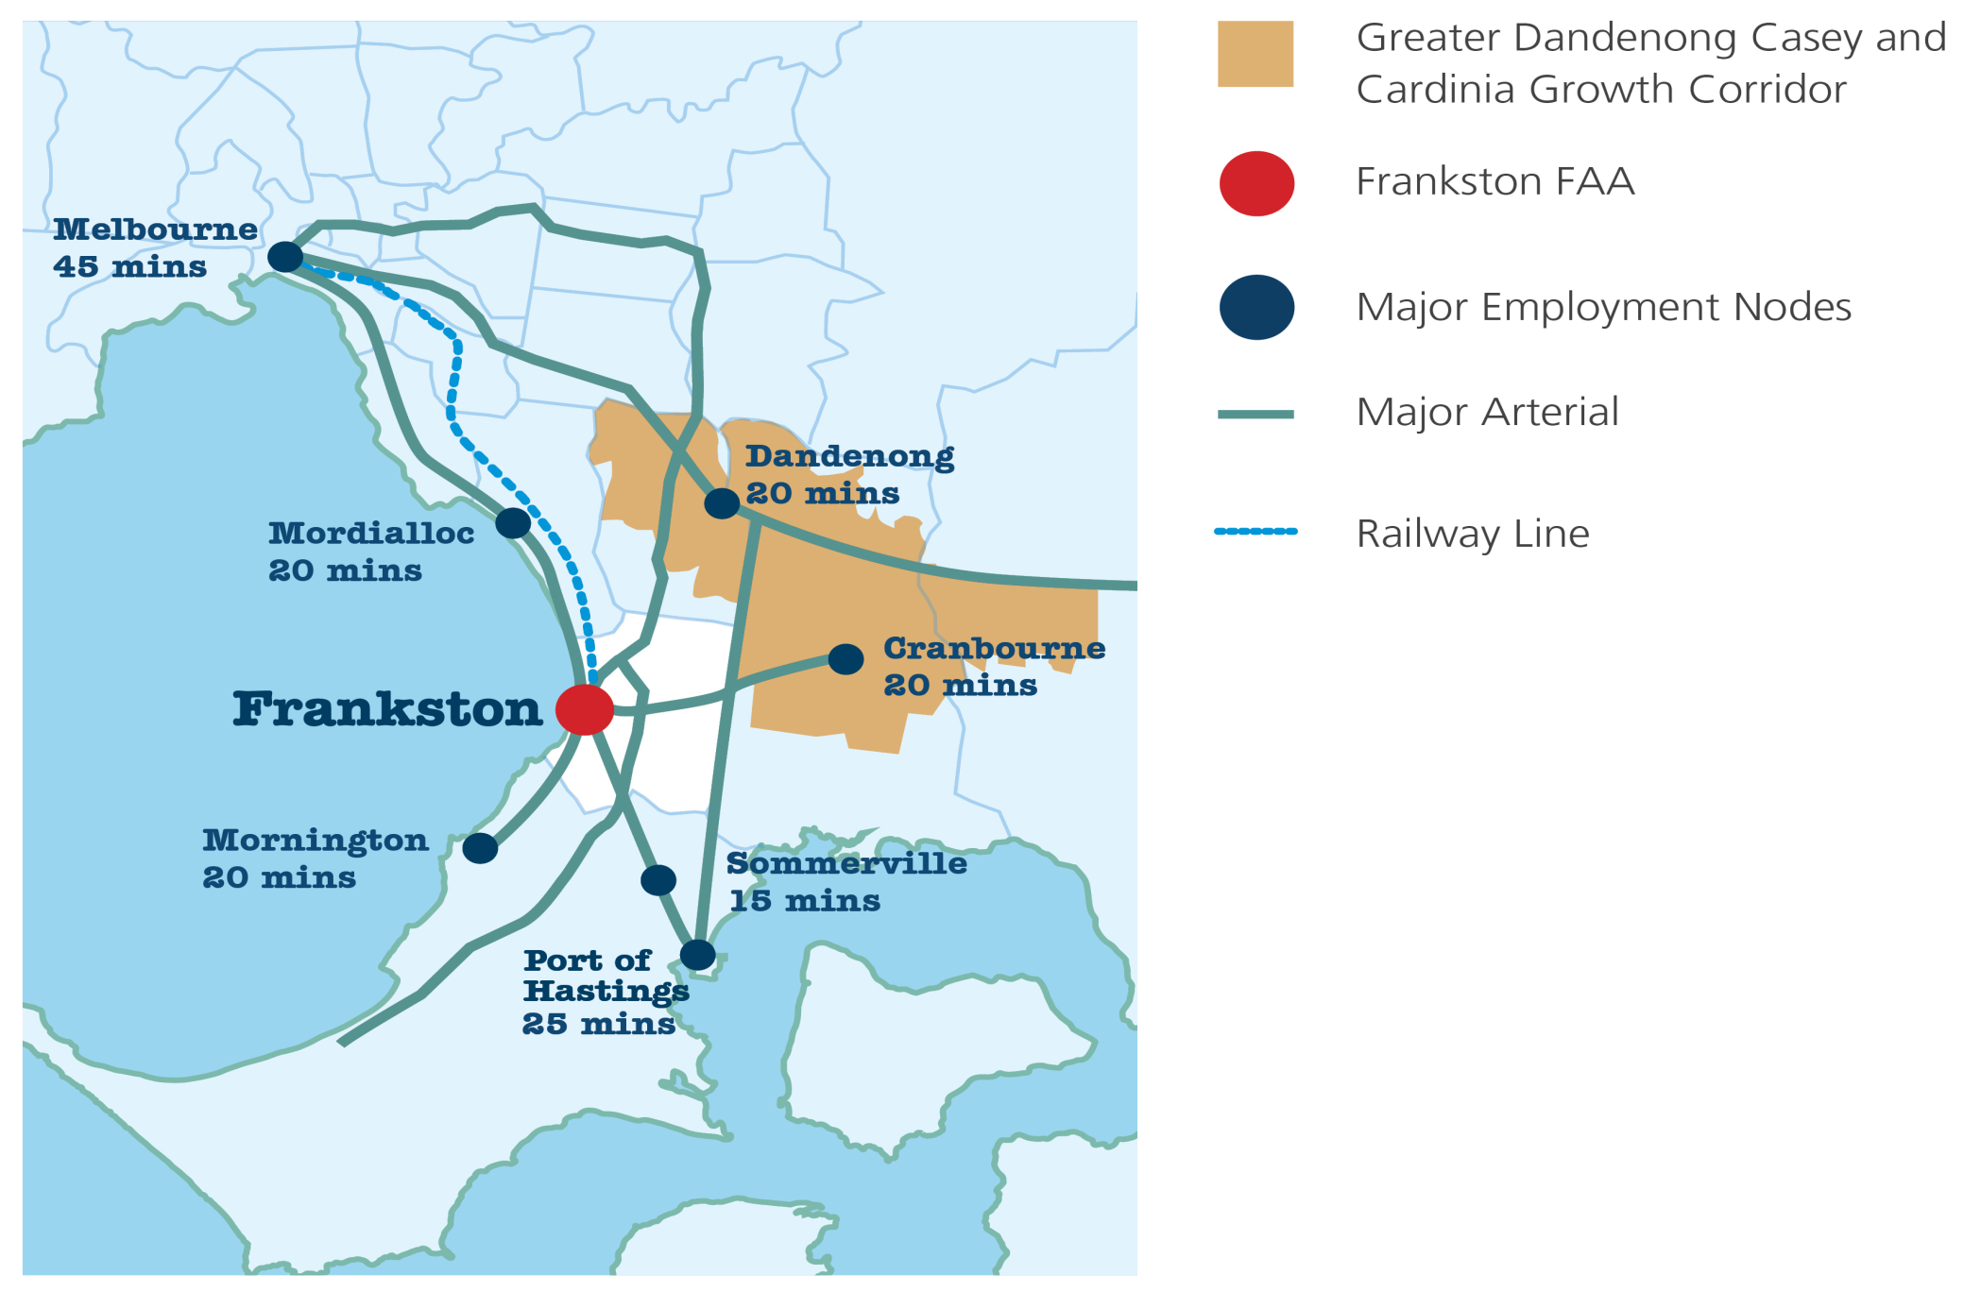
REGIONAL CONTEXT

Slide 7
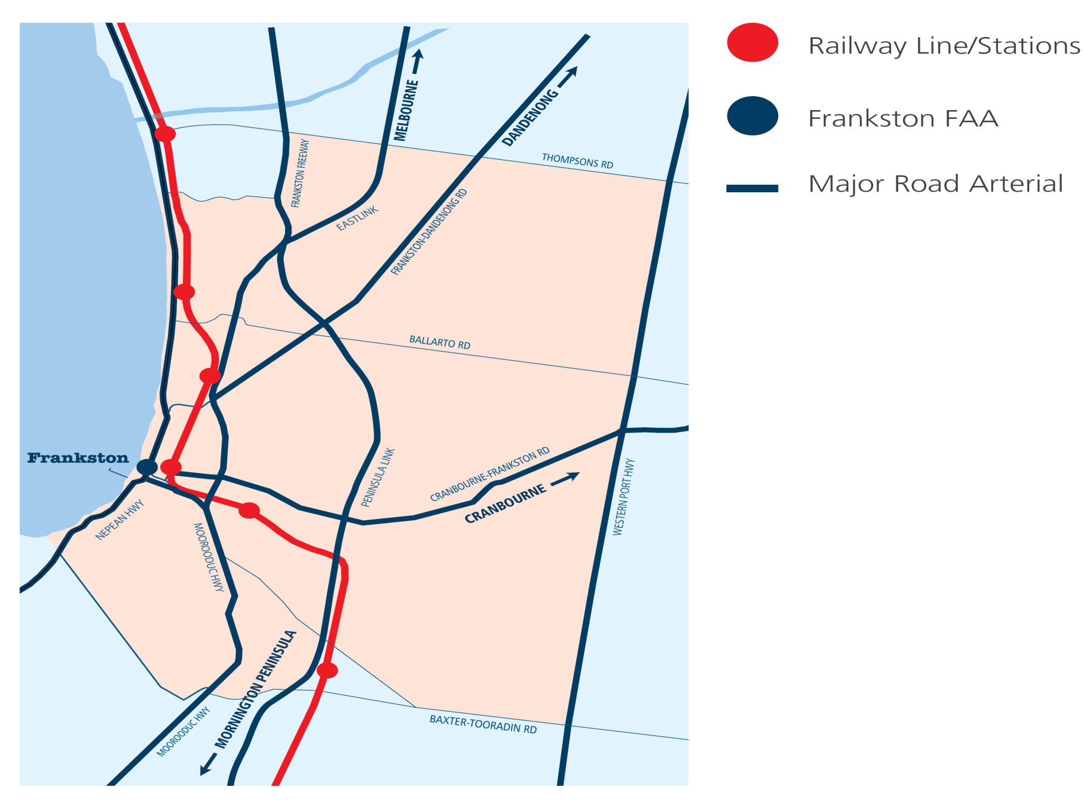
ACCESSIBILITY

Slide 8
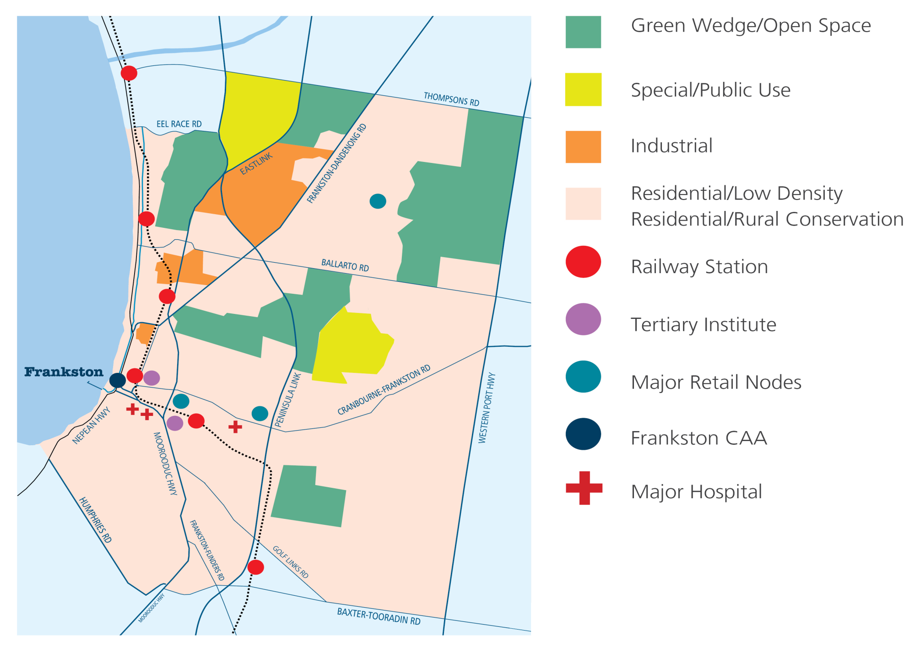
LAND USE

Slide 9
PRODUCTIVE OUTPUT

Slide 10
EMPLOYMENT GROWTH

Slide 11
Median House Prices
 | 2006 | 2008 | 2010 | 2012 | 2013* | % Change
Melbourne Metro | $375,000 | $451,000 | $559,000 | $535,000 | $545,000 | 45%
Mordialloc | $385,000 | $540,000 | $610,000 | $642,500 | $655,500 | 70%
Cranbourne | $220,000 | $266,000 | $305,000 | $315,000 | $316,250 | 44%
Frankston | $237,500 | $300,000 | $349,000 | $345,000 | $360,000 | 52%
Carrum Downs | $172,500 | $230,000 | $260,600 | $253,000 | $316,000 | 83%
Seaford | $237,500 | $300,000 | $349,000 | $345,000 | $407,250 | 71%
Langwarrin | $265,000 | $324,475 | $372,000 | $380,000 | $430,000 | 62%
Mornington | $325,000 | $385,000 | $470,000 | $500,000 | $520,000 | 60%
Baxter | $220,000 | $250,000 | $304,000 | $312,500 | $329,000 | 50%
Hastings | $213,000 | $272,500 | $317,000 | $349,000 | $327,000 | 54%

Slide 12
The future for Frankston?
Recent commitments by State government
Some key initiatives:
Project | Cost
Frankston rail-line | $100M
Frankston transit interchange | $13.8M
Peninsula Link | $730M
Eastlink | $2.5B

Slide 13
Investment in Frankston
2007 - 2013
Residential - $197M
Commercial - $127M
Industrial - $84M
Council facilities - $51M
Council parks and recreation - $35M
Foreshore - $22M

Slide 14
Current projects
Frankston Regional Aquatic Health and Wellbeing Centre - $46.35M
Trade Training Centre at Chisholm Institute - $19M
Redevelopment of the former Peninsula Centre into ‘Peninsula on the Bay’ incorporating Quest accommodation, restaurants and café’s
South East Water HQ - $80M
Hospitals
Frankston Stage 3 - $36M
- Frankston Private - $25M

Slide 15
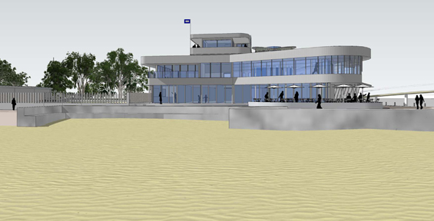
Planned Frankston Yacht Club Redevelopment

Slide 16
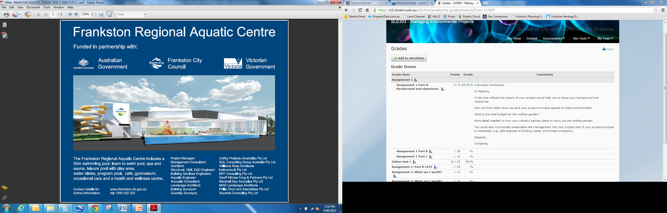
Frankston Aquatic Centre

Slide 17
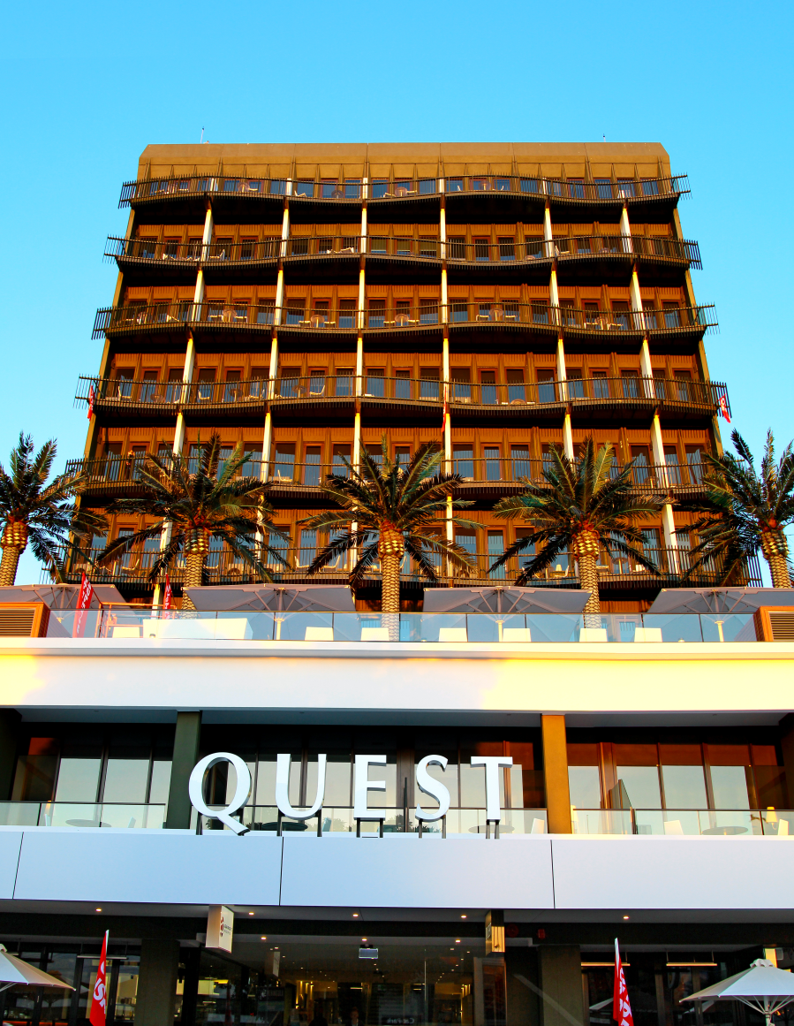
Quest apartments - $25M
Redevelopment of Peninsula Centre by Asia Pacific

Slide 18

Thanks to… & testimonials

